Slide 1
Bayesian models
Its all about that Bayes

Slide 2
Question
You are the general manager of a Baseball team
You have a new player, and you want to assess his bating average
Bating average: the proportion of time you hit the ball and the get to first base
The new player had 10 trials and made 8 hits and 2 misses.
How much you would estimate his batting average?

Slide 3
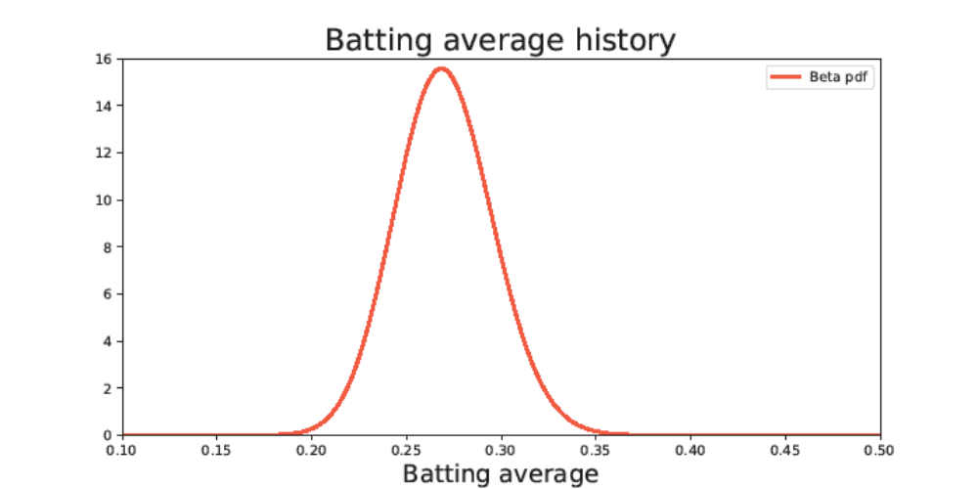
The batting average of baseball players
The best player ever did not exceed 0.4.
What do you think now?

Slide 4
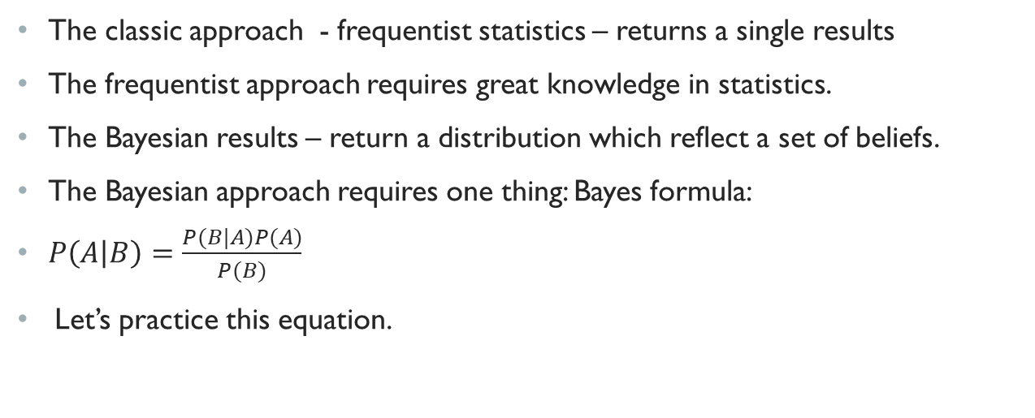
What is make a model Bayesian?
The classic approach - frequentist statistics – returns a single results
The frequentist approach requires great knowledge in statistics.
The Bayesian results – return a distribution which reflect a set of beliefs.
The Bayesian approach requires one thing: Bayes formula:
$P\left(A | B\right)=\frac{P(B|A)P(A)}{P(B)}$
Let’s practice this equation.

Slide 5
Let practice Bayes
2
1
We have two vessels: 1 and 2 which contains balls
Vessels 1: has 1 red ball and 1 blue ball
Vessels 2: has 1 red ball and 2 blue balls
One of the ball is randomly picked.
Event A: choosing vessel 1
Event B: choosing a red ball
Question: a red ball is picked, what is the probability that it was from vessel 1?

Slide 6

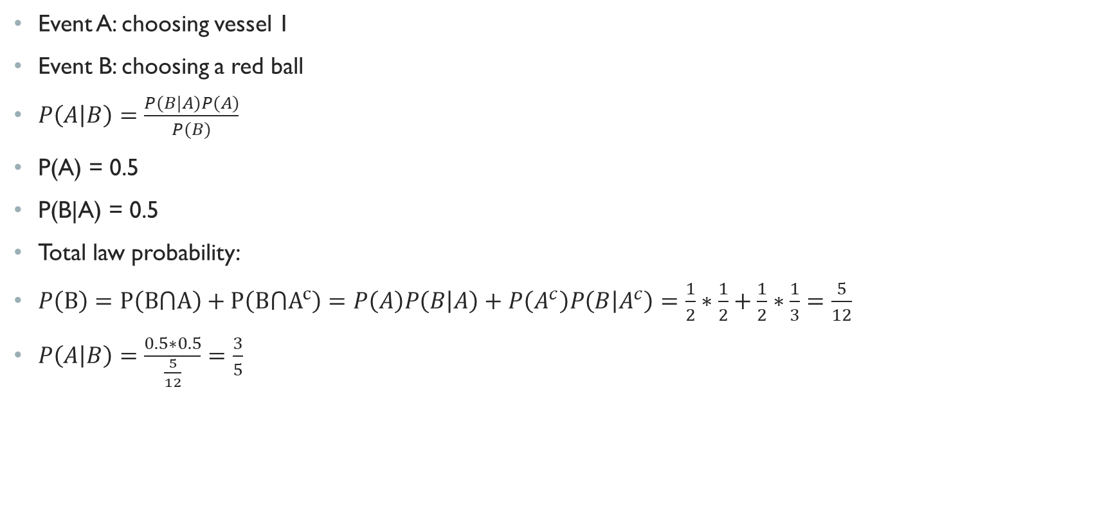
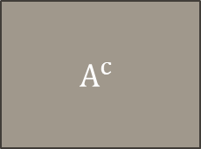
Let’s practice Bayes
2
1
B
Event A: choosing vessel 1
Event B: choosing a red ball
$P\left(A | B\right)=\frac{P(B|A)P(A)}{P(B)}$
P(A) = 0.5
P(B|A) = 0.5
Total law probability:
$P\left(B\right)=P\left(B⋂A\right)+P\left({B⋂A}^{c}\right)=P\left(A\right)P\left(B | A\right)+P\left(A^{c}\right)P\left(B | A^{c}\right)=\frac{1}{2}∗\frac{1}{2}+\frac{1}{2}∗\frac{1}{3}=\frac{5}{12}$
$P\left(A | B\right)=\frac{0.5∗0.5}{\frac{5}{12}}=\frac{3}{5}$
$$A$$
$$A^{c}$$

Slide 7
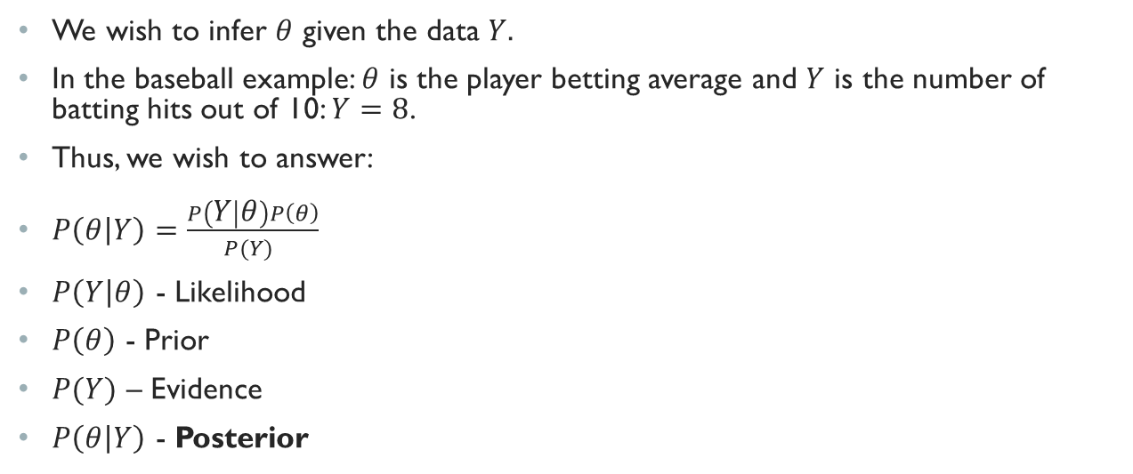
Bayes Formula with data
We wish to infer $θ$ given the data $Y.$
In the baseball example: $θ$ is the player betting average and $Y$ is the number of batting hits out of 10: $Y=8$.
Thus, we wish to answer:
$P\left(θ | Y\right)=\frac{P\left(Y | θ\right)P\left(θ\right)}{P(Y) }$
$P\left(Y | θ\right)$ - Likelihood
$P\left(θ\right)$ - Prior
$P(Y)$ – Evidence
$P\left(θ | Y\right)$ - Posterior

Slide 8

Likelihood - Geometric
בקורס הכנה לפסיכומטרי נשאלים התלמידים שאלות הכנה על ידי המדריך על מנת להכין אותם לבחינה. (נלקח מהרצאה של שני אלקובי).
הסיכוי ששאלה שניתנה לתלמידים תגרום להם להיות מוכנים לגמרי הוא $p$. ברגע שהתלמידים יהיו מוכנים המדריך ישיג את מטרתו ויפסיק לשאול.
האם מדובר בהתפלגות מוכרת? אם כן, מהי?
  פתרון:
  כיוון שמספר הניסויים אינו ידוע, הסיכוי להצלחה קבוע, והמדריך ימשיך לנסות עד שיצליח להכין אותם לבחינה ואז יפסיק, אנחנו מבינים שמדובר על התפלגות גיאומטרית. נסמן זאת באופן הבא:
  $$X\sim G\left(p\right)$$
  כאשר $X$ הוא מספר הניסיונות עד וכולל ההצלחה הראשונה ו $p$ הוא הסיכוי להצלחה בכל פעם.

Slide 9
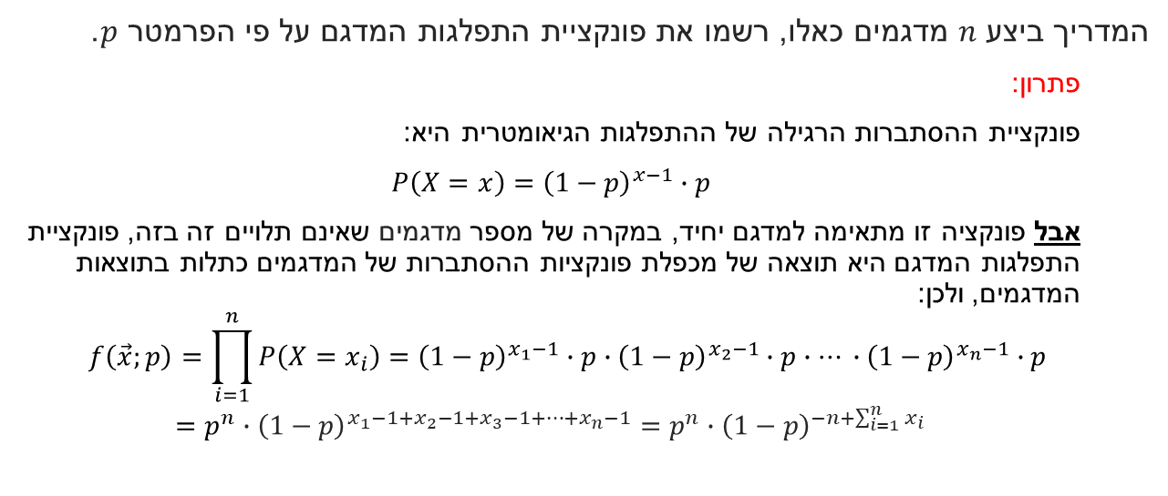
Likelihood - Geometric
המדריך ביצע $n$ מדגמים כאלו, רשמו את פונקציית התפלגות המדגם על פי הפרמטר $p$.
  פתרון:
  פונקציית ההסתברות הרגילה של ההתפלגות הגיאומטרית היא:
  ${\left(1−p\right)}^{x−1}∙p$ $P\left(X=x\right)=$
  אבל פונקציה זו מתאימה למדגם יחיד, במקרה של מספר מדגמים שאינם תלויים זה בזה, פונקציית התפלגות המדגם היא תוצאה של מכפלת פונקציות ההסתברות של המדגמים כתלות בתוצאות המדגמים, ולכן:
  $$f\left(\vec{x};p\right)=\prod_{i=1}^{n}{P\left(X=x_{i}\right)={\left(1−p\right)}^{x_{1}−1}∙p∙{\left(1−p\right)}^{x_{2}−1}∙p∙… ∙}{\left(1−p\right)}^{x_{n}−1}∙p$$
  $$=p^{n}∙{\left(1−p\right)}^{x_{1}−1+x_{2}−1+x_{3}−1+…+x_{n}−1}=p^{n}∙{\left(1−p\right)}^{−n+\sum_{i=1}^{n}{x_{i}}}$$

Slide 10
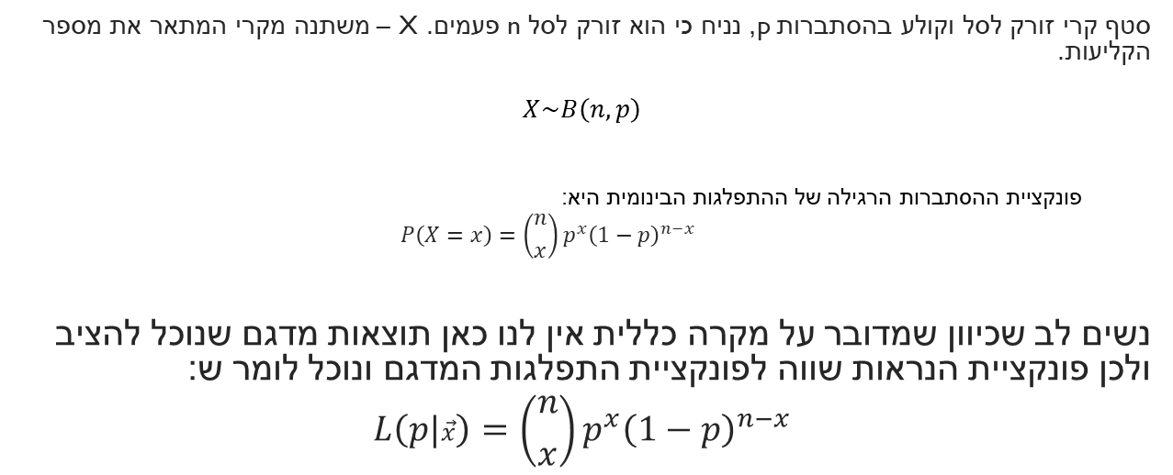
Likelihood - Binomial
סטף קרי זורק לסל וקולע בהסתברות p, נניח כי הוא זורק לסל n פעמים. X – משתנה מקרי המתאר את מספר הקליעות.
$$X\sim B\left(n,p\right)$$
  פונקציית ההסתברות הרגילה של ההתפלגות הבינומית היא:
  $$P\left(X=x\right)=\left({n \atop x}\right)p^{x}{\left(1−p\right)}^{n−x}$$
נשים לב שכיוון שמדובר על מקרה כללית אין לנו כאן תוצאות מדגם שנוכל להציב ולכן פונקציית הנראות שווה לפונקציית התפלגות המדגם ונוכל לומר ש:
$$L\left(p|\vec{x}\right)=\left({n \atop x}\right)p^{x}{\left(1−p\right)}^{n−x}$$

Slide 11
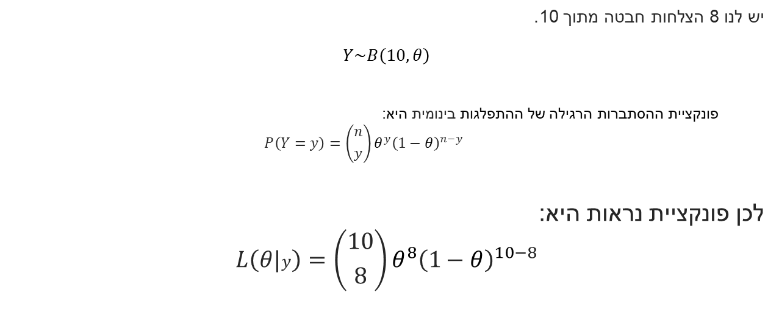
Likelihood – Baseball example
יש לנו 8 הצלחות חבטה מתוך 10.
$$Y\sim B\left(10,θ\right)$$
  פונקציית ההסתברות הרגילה של ההתפלגות בינומית היא:
  $$P\left(Y=y\right)=\left({n \atop y}\right)θ^{y}{\left(1−θ\right)}^{n−y}$$
לכן פונקציית נראות היא:
$$L\left(θ|y\right)=\left({10 \atop 8}\right)θ^{8}{\left(1−θ\right)}^{10−8}$$

Slide 12
Prior
Represents our initial belief about a parameter before
Uninformative (Non-Informative) Priors
  Used when we have little prior knowledge.
  Example: A Uniform(0,1) prior for a probability parameter expresses complete ignorance.
Conjugate Priors
  A prior is conjugate if the posterior belongs to the same family as the prior.
  Example: If the likelihood is Binomial, the Beta distribution is a conjugate prior.
Informative Priors:
  Used when we have prior knowledge about the parameter.

Slide 13
Informative priors
For batting average, we wish to use a distributions that is between 0 to 1.
We use Beta distribution:

Slide 14
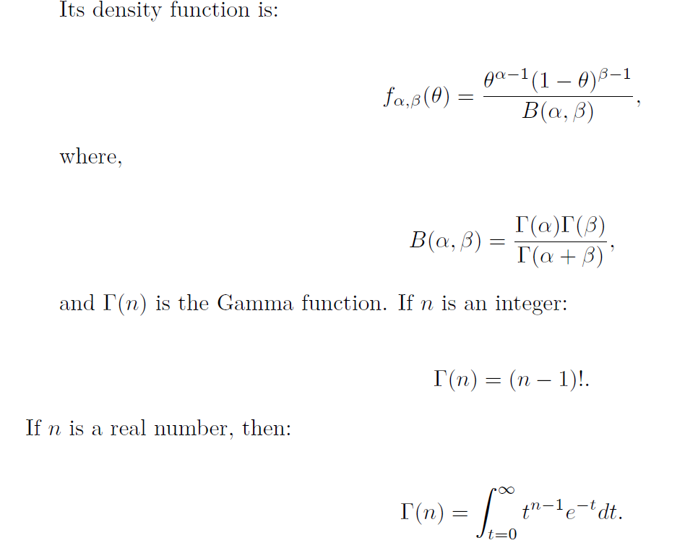


Beta distribution
$$θ\sim Beta\left(α, β\right)$$
$$E\left[θ\right]=\frac{α}{α+β}$$

Slide 15
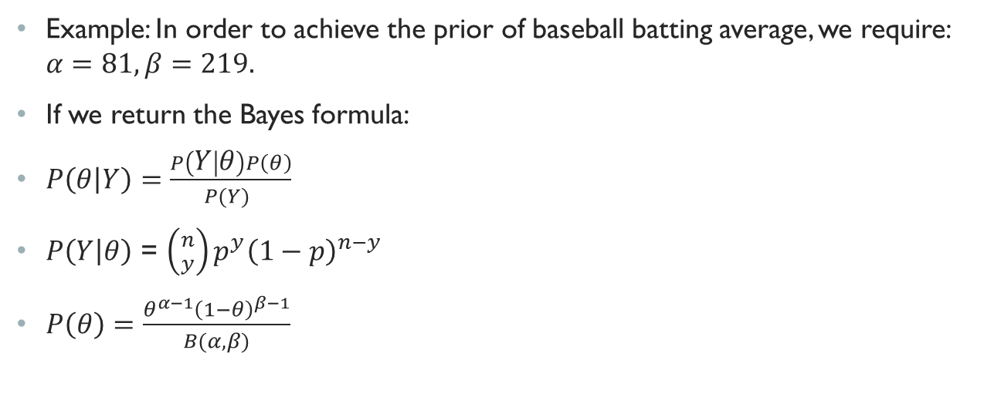
Beta prior
Example: In order to achieve the prior of baseball batting average, we require: $α=81, β=219.$
If we return the Bayes formula:
$P\left(θ | Y\right)=$ $\frac{P\left(Y | θ\right)P\left(θ\right)}{P(Y) }$
$P\left(Y | θ\right)$ = $\left({n \atop y}\right)p^{y}{\left(1−p\right)}^{n−y}$
$P\left(θ\right)=\frac{θ^{α−1}{\left(1−θ\right)}^{β−1}}{B(α, β)}$

Slide 16
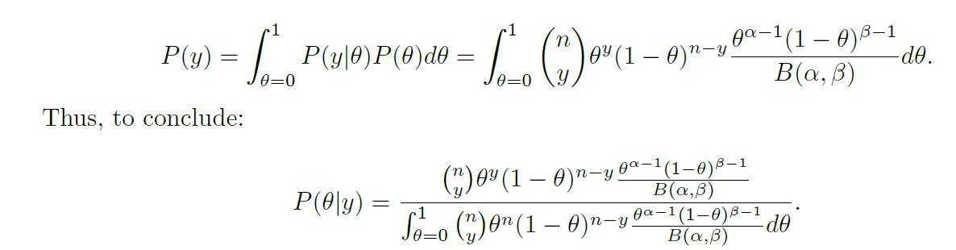
Evidence
We’ll use the total law of probability:

Slide 17
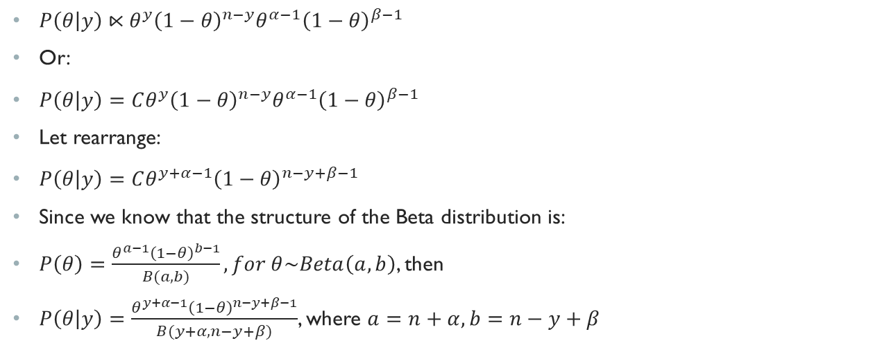
Posterior – Baseball example
$P\left(θ | y\right)⋉θ^{y}{\left(1−θ\right)}^{n−y}θ^{α−1}{\left(1−θ\right)}^{β−1}$
Or:
$P\left(θ | y\right)=Cθ^{y}{\left(1−θ\right)}^{n−y}θ^{α−1}{\left(1−θ\right)}^{β−1}$
Let rearrange:
$P\left(θ | y\right)=Cθ^{y+α−1}{\left(1−θ\right)}^{n−y+β−1}$
Since we know that the structure of the Beta distribution is:
$P\left(θ\right)=\frac{θ^{a−1}{\left(1−θ\right)}^{b−1}}{B(a, b)}, for θ\sim Beta\left(a,b\right)$, then
$P\left(θ | y\right)=\frac{θ^{y+α−1}{\left(1−θ\right)}^{n−y+β−1}}{B(y+α, n−y+β)}$, where $a=n+α, b=n−y+β$

Slide 18
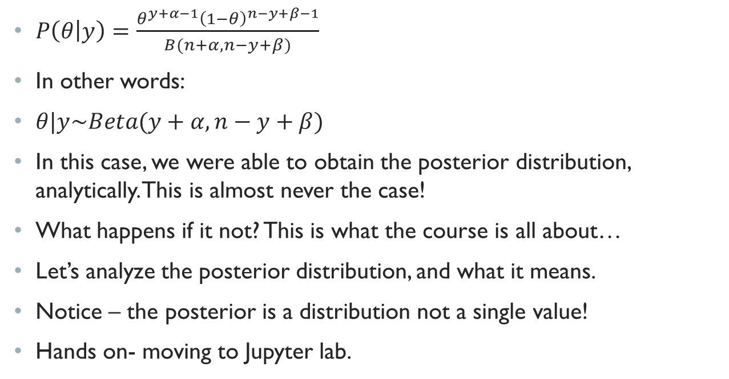
Posterior
$P\left(θ | y\right)=\frac{θ^{y+α−1}{\left(1−θ\right)}^{n−y+β−1}}{B(n+α, n−y+β)}$
In other words:
$θ|y\sim Beta(y+α,n−y+β)$
In this case, we were able to obtain the posterior distribution, analytically. This is almost never the case!
What happens if it not? This is what the course is all about…
Let’s analyze the posterior distribution, and what it means.
Notice – the posterior is a distribution not a single value!
Hands on- moving to Jupyter lab.

Slide 19
Analyzing posterior
The posterior is a set of belief where the true parameter is.
When observing the posterior, we wish to look for several things:
  The support: the feasible values
  The variance of the distribution – to see how certain we are
  The mode of the distribution – to see what it the most likely values

Slide 20
Computing Posterior
In the baseball example, we knew the distribution of the Posterior.
We could identify it as Beta distribution
What happens if this is not the case??
We try a new approach - sampling from the posterior
Before we show how it is done, let's see how sampling can get us closer to the distribution.

Slide 21
HDI
HDI is: Highest Density Interval. This is also considered as the suggested credible interval.
Credible intervals capture our current uncertainty in the location of the parameter values and thus can be interpreted as probabilistic statement about the parameter.
In contrast, confidence intervals (the frequentist approach) capture the uncertainty about the interval we have obtained (i.e., whether it contains the true value or not). Thus, they cannot be interpreted as a probabilistic statement about the true parameter values.

Slide 22
Inference problem
You have some data x and you are trying to estimate θ.
You have a data generating process that describes how x is generated conditional on θ.
Your inference problem is: What values of θ are reasonable given the observed data x?

Slide 23
Frequentist – confidence interval
In this approach, you assume that there is true, fixed value of θ.
Given this assumption, you use the data x to get to an estimate of θ.
Notice that under this approach the true value is not a random variable.
It is a fixed but unknown quantity.
In contrast, your estimate is a random variable as it depends on your data x.
you realize that you get different estimates each time you repeat your study.
In this paradigm, it is meaningless to speak about the probability that a true value is less than or greater than some value as the true value is not a random variable

Slide 24
Bayesian - Credible Intervals
We assume that the true value is a random variable.
It is an interval that contains the true parameter with X% probability, given the observed data.
Data is fixed, the parameter is treated as a random variable.
It is computed via the posterior distribution.

